Slide 1
RecSys
CS771: Introduction to Machine Learning
Purushottam Kar

Slide 2
Recommendation Systems
Recommendation Systems are ubiquitous in various fields
Social networks, e-commerce but also medicine, governance, services
RecSys face severe data imbalance as well as gigantic datasets
Extremely lucrative for monetization
Very active area with several conferences publishing works
RecSys, WSDM,ICML, NeurIPS, KDD, WWW
Will look at two approaches
Collaborative Filtering via Matrix Completion
Extreme Multilabel Classification
Will also look at how to perform online recommendations

Slide 3













Abstract Problem Statement
There are users …
… and there are items …
Users come to us one at a time in no particular order
… and we need to recommend, to each user, items they will “like”
User tastes expected to be stable but may vary slowing across time

Slide 4
Applications of RecSys
User
sundarbans.com user
reddit.com user
Student
Patient
Search query
Advertiser
Items
sundarbans.com products
Reddit posts
Study material
Medicines
Advertisements
Search query to bid on
“Users” are often in millions and thousands may come each second
“Items” are often in millions and each user likes very few e.g. 5-10 items
Some items are popular but most items liked by very few e.g. 5-10 users

Slide 5
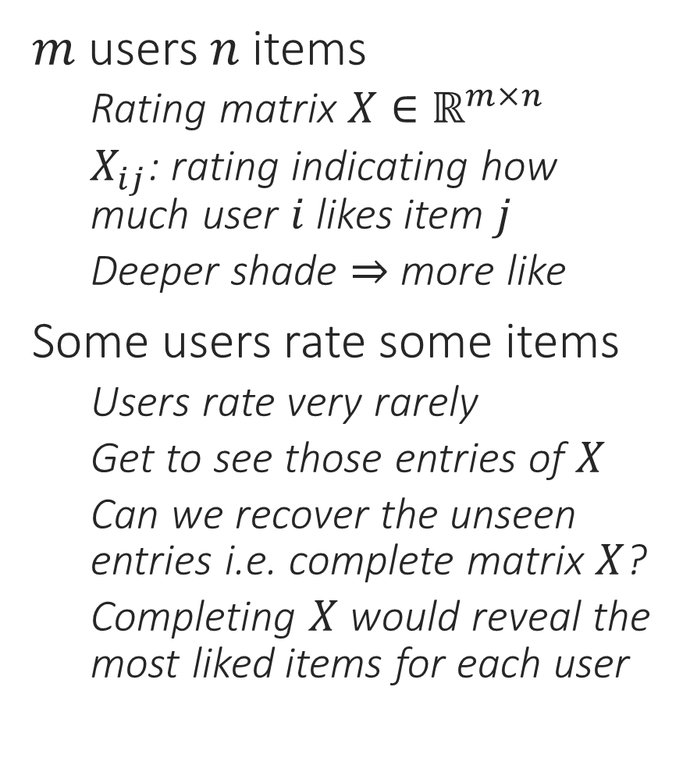
The Matrix Completion Problem
We do not assume we have access to any user/item features in this model (instead we will learn them by modelling them as latent variables). There are other models where we assume we are given user/item features.
$m$ users $n$ items
Rating matrix $X∈ℝ^{m×n}$
$X_{ij}$: rating indicating how much user $i$ likes item $j$
Deeper shade $⇒$ more like
Some users rate some items
Users rate very rarely
Get to see those entries of $X$
Can we recover the unseen entries i.e. complete matrix $X$?
Completing $X$ would reveal the most liked items for each user
?
?
?
?
?
?
?
?
?
?
?
?
?
?
?
?
?
?
?
?
?
?
?
?
?
?
?

Slide 6
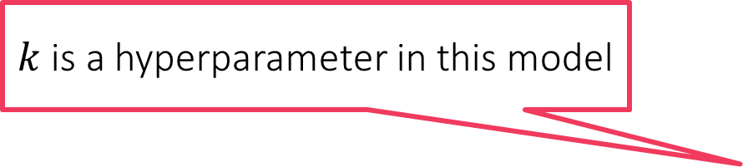
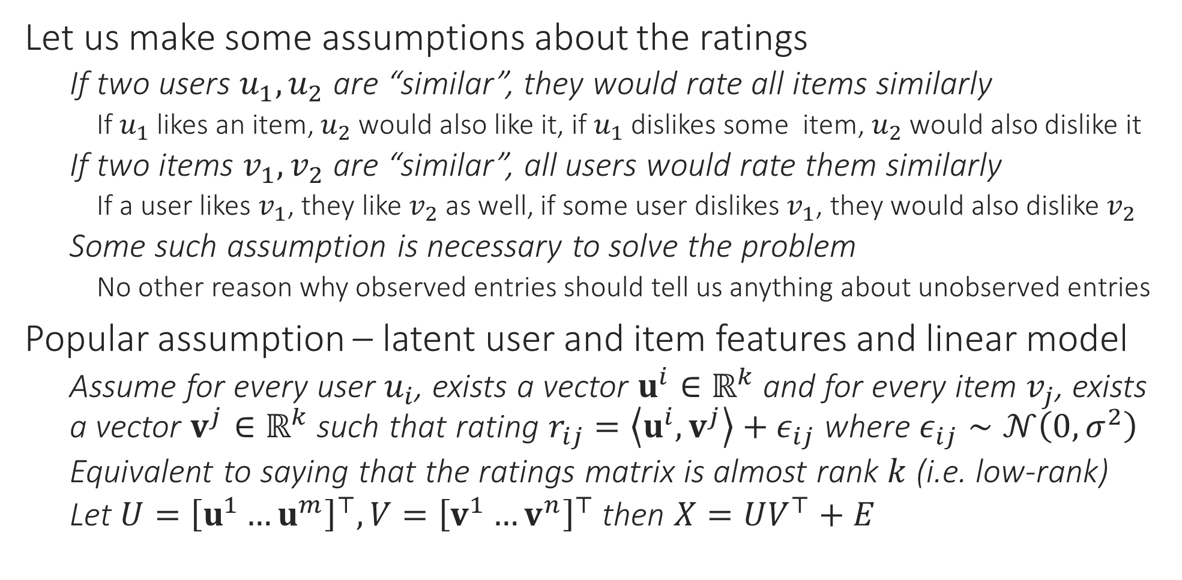
Low-rank Matrix Completion
$k$ is a hyperparameter in this model
Let us make some assumptions about the ratings
If two users $u_{1},u_{2}$ are “similar”, they would rate all items similarly
If $u_{1}$ likes an item, $u_{2}$ would also like it, if $u_{1}$ dislikes some item, $u_{2}$ would also dislike it
If two items $v_{1},v_{2}$ are “similar”, all users would rate them similarly
If a user likes $v_{1}$, they like $v_{2}$ as well, if some user dislikes $v_{1}$, they would also dislike $v_{2}$
Some such assumption is necessary to solve the problem
No other reason why observed entries should tell us anything about unobserved entries
Popular assumption – latent user and item features and linear model
Assume for every user $u_{i}$, exists a vector $u^{i}∈ℝ^{k}$ and for every item $v_{j}$, exists a vector $v^{j}∈ℝ^{k}$ such that rating $r_{ij}=\left\langle u^{i},v^{j}\right\rangle +ε_{ij}$ where $ε_{ij}∼𝒩\left(0,σ^{2}\right)$
Equivalent to saying that the ratings matrix is almost rank $k$ (i.e. low-rank)
Let $U={\left[u^{1}…u^{m}\right]}^{⊤},V={\left[v^{1}…v^{n}\right]}^{⊤}$ then $X=UV^{⊤}+E$

Slide 7


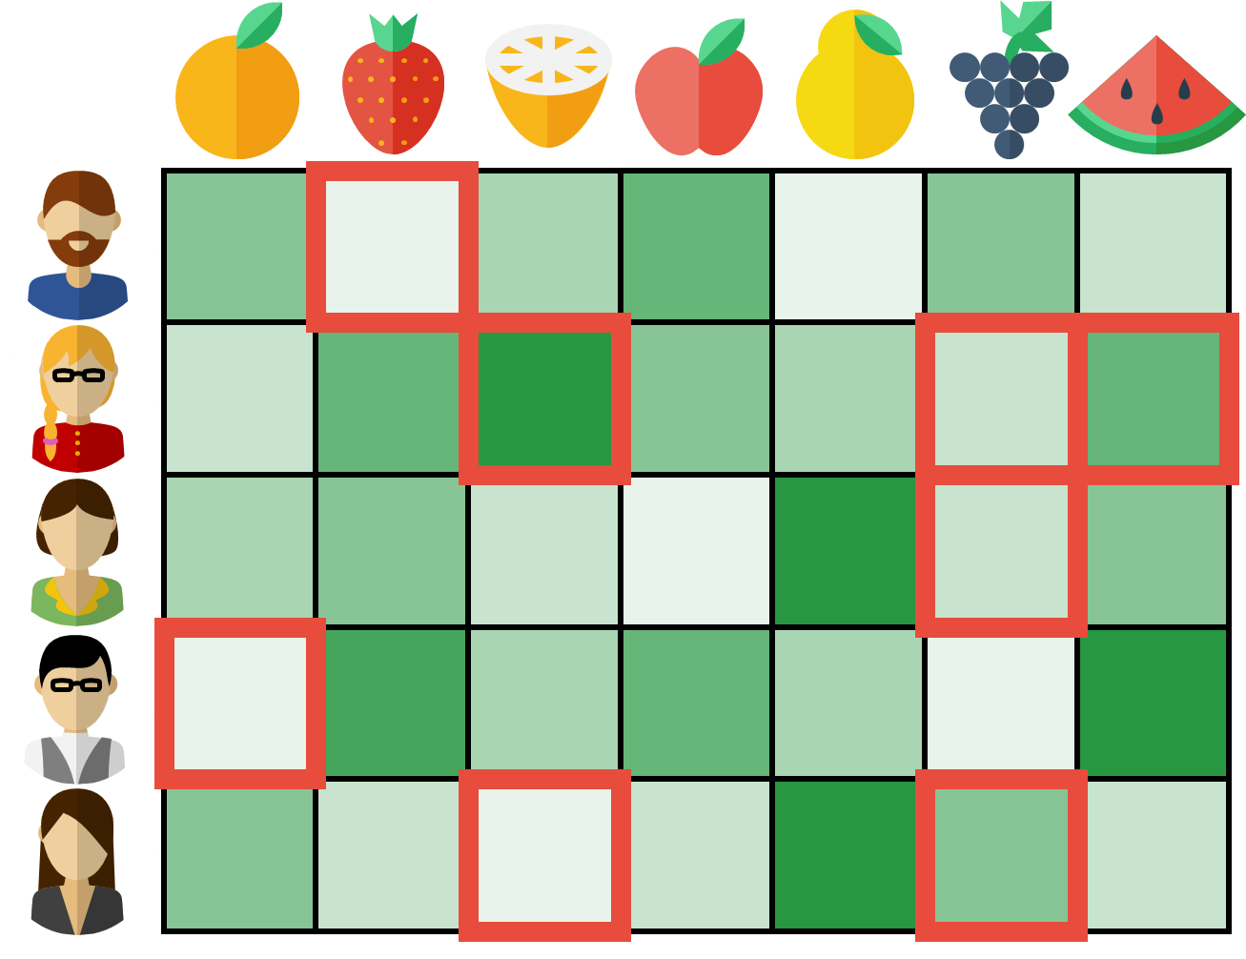






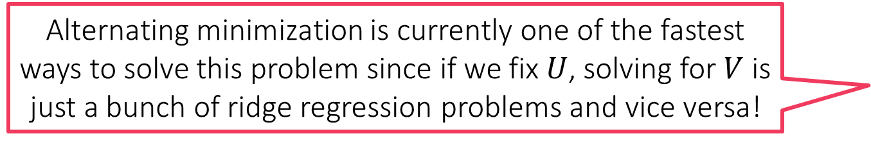
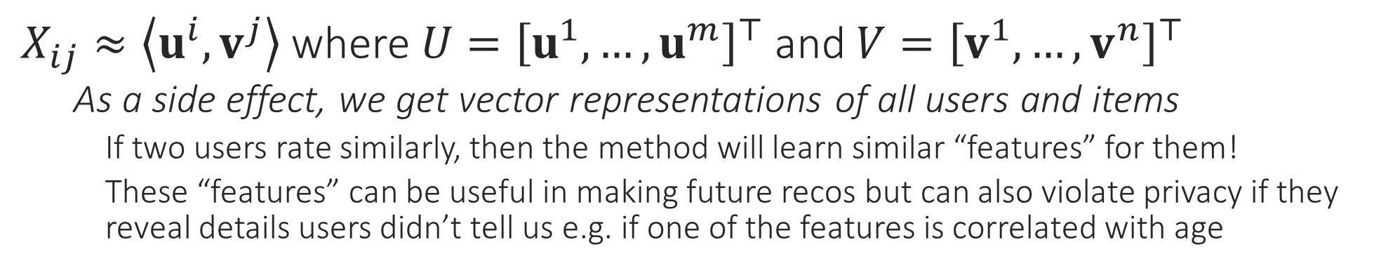
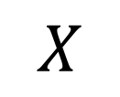
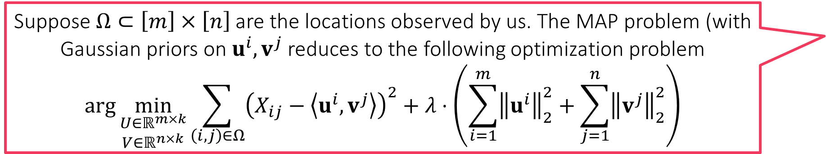
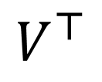
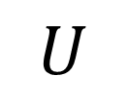

Low-rank Matrix Completion
$$k$$
$$k$$
$$V^{⊤}$$
ITEM FEATURES
Suppose $Ω⊂\left[m\right]×\left[n\right]$ are the locations observed by us. The MAP problem (with Gaussian priors on $u^{i},v^{j}$ reduces to the following optimization problem
$$\arg{\min_{\begin{aligned}U∈ℝ^{m×k} \\ V∈ℝ^{n×k}\end{aligned}}{\sum_{\left(i,j\right)∈Ω}{{\left(X_{ij}−\left\langle u^{i},v^{j}\right\rangle \right)}^{2}}+λ⋅\left(\sum_{i=1}^{m}{{\left\|u^{i}\right\|}_{2}^{2}}+\sum_{j=1}^{n}{{\left\|v^{j}\right\|}_{2}^{2}}\right)}}$$
$$U$$
$$X$$
USER FEATURES
$X_{ij}≈\left\langle u^{i},v^{j}\right\rangle$ where $U={\left[u^{1},…,u^{m}\right]}^{⊤}$ and $V={\left[v^{1},…,v^{n}\right]}^{⊤}$
As a side effect, we get vector representations of all users and items
If two users rate similarly, then the method will learn similar “features” for them!
These “features” can be useful in making future recos but can also violate privacy if they reveal details users didn’t tell us e.g. if one of the features is correlated with age
Alternating minimization is currently one of the fastest ways to solve this problem since if we fix $U$, solving for $V$ is just a bunch of ridge regression problems and vice versa!

Slide 8

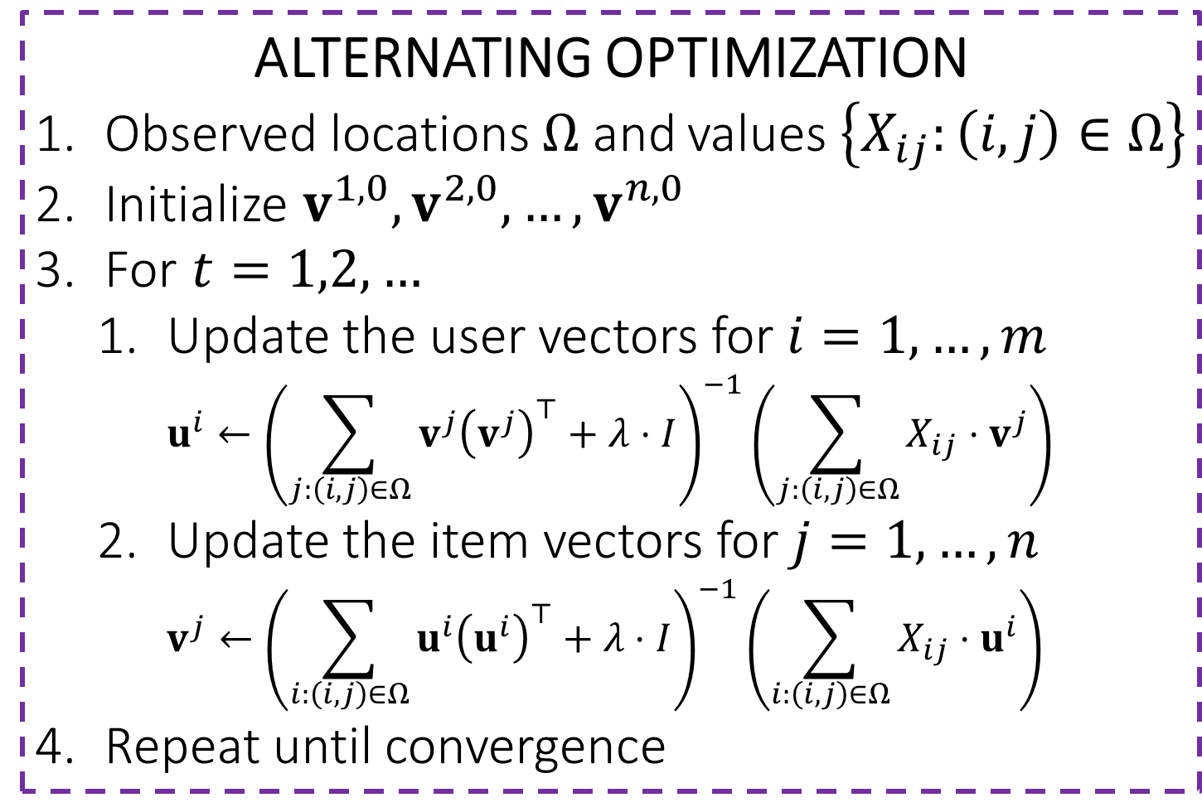

AltMin for LRMC
ALTERNATING OPTIMIZATION
Observed locations $Ω$ and values $\left\{X_{ij}:\left(i,j\right)∈Ω\right\}$
Initialize $v^{1,0},v^{2,0},…,v^{n,0}$
For $t=1,2,…$
Update the user vectors for $i=1,…,m$ $u^{i}←{\left(\sum_{j:\left(i,j\right)∈Ω}{v^{j}{\left(v^{j}\right)}^{⊤}}+λ⋅I\right)}^{−1}\left(\sum_{j:\left(i,j\right)∈Ω}{X_{ij}⋅v^{j}}\right)$
Update the item vectors for $j=1,…,n$ $v^{j}←{\left(\sum_{i:\left(i,j\right)∈Ω}{u^{i}{\left(u^{i}\right)}^{⊤}}+λ⋅I\right)}^{−1}\left(\sum_{i:\left(i,j\right)∈Ω}{X_{ij}⋅u^{i}}\right)$
Repeat until convergence
Note: sum only over items that user $i$ rated (small for most users)
Note: sum only over users that rated item $j$ (small for most items)

Slide 9
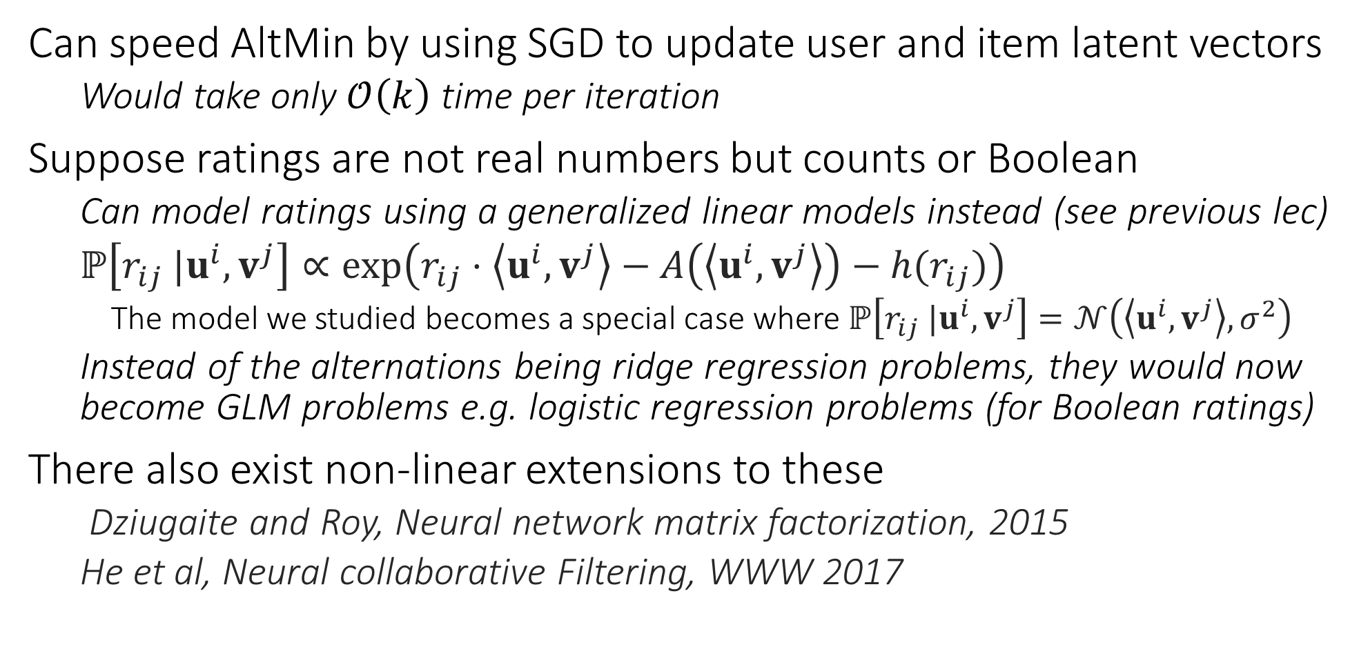
Interesting Extensions
Can speed AltMin by using SGD to update user and item latent vectors
Would take only $𝒪\left(k\right)$ time per iteration
Suppose ratings are not real numbers but counts or Boolean
Can model ratings using a generalized linear models instead (see previous lec)
$ℙ\left[r_{ij} |u^{i},v^{j}\right]∝\exp\left(r_{ij}⋅\left\langle u^{i},v^{j}\right\rangle −A\left(\left\langle u^{i},v^{j}\right\rangle \right)−h(r_{ij})\right)$
The model we studied becomes a special case where $ℙ\left[r_{ij} |u^{i},v^{j}\right]=𝒩\left(\left\langle u^{i},v^{j}\right\rangle ,σ^{2}\right)$
Instead of the alternations being ridge regression problems, they would now become GLM problems e.g. logistic regression problems (for Boolean ratings)
There also exist non-linear extensions to these
Dziugaite and Roy, Neural network matrix factorization, 2015
He et al, Neural collaborative Filtering, WWW 2017

Slide 10
Collaborative Filtering
Pros
Relies purely on behavioural data
Does not require users to submit personal information
Does not require sellers to submit item information
Collaborative method: lazy users benefit from active users
Cons
Relies purely on behavioural data
Cannot utilize user and item information even if present
Expensive to recompute matrix factorization again and again
Adding new users and items not straightforward (cold start problem)

Slide 11
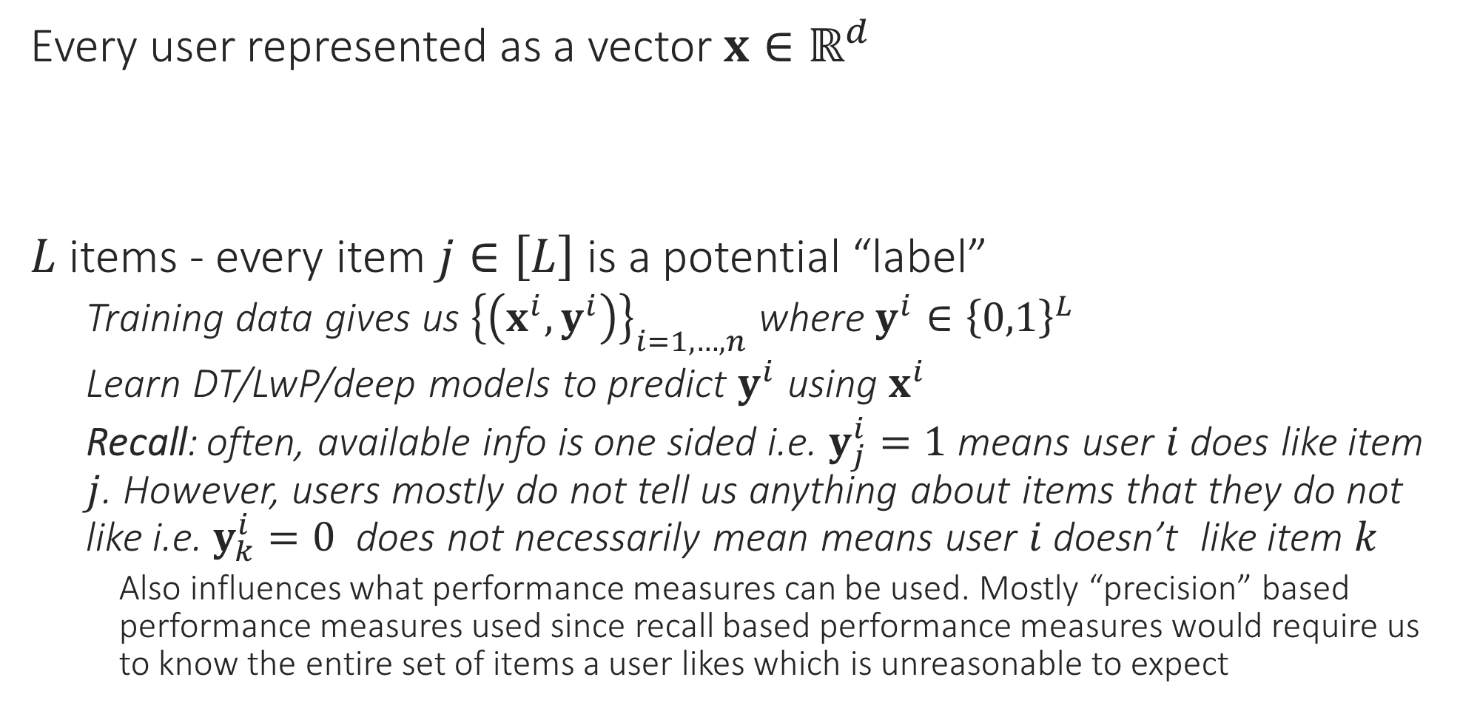
Recommendation as Multi-label Learning
Every user represented as a vector $x∈ℝ^{d}$
$L$ items - every item $j∈\left[L\right]$ is a potential “label”
Training data gives us ${\left\{\left(x^{i},y^{i}\right)\right\}}_{i=1,…,n}$ where $y^{i}∈{\left\{0,1\right\}}^{L}$
Learn DT/LwP/deep models to predict $y^{i}$ using $x^{i}$
Recall: often, available info is one sided i.e. $y_{j}^{i}=1$ means user $i$ does like item $j$. However, users mostly do not tell us anything about items that they do not like i.e. $y_{k}^{i}=0$ does not necessarily mean means user $i$ doesn’t like item $k$
Also influences what performance measures can be used. Mostly “precision” based performance measures used since recall based performance measures would require us to know the entire set of items a user likes which is unreasonable to expect

Slide 12

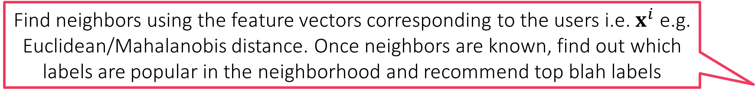
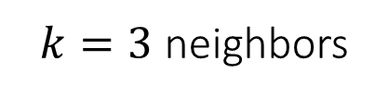
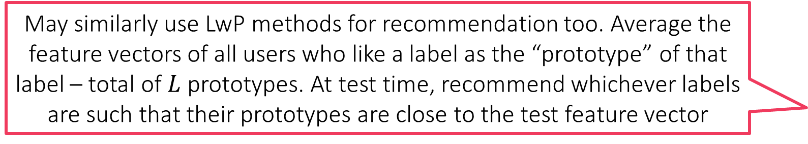
Recommendation using kNN
Find neighbors using the feature vectors corresponding to the users i.e. $x^{i}$ e.g. Euclidean/Mahalanobis distance. Once neighbors are known, find out which labels are popular in the neighborhood and recommend top blah labels
May similarly use LwP methods for recommendation too. Average the feature vectors of all users who like a label as the “prototype” of that label – total of $L$ prototypes. At test time, recommend whichever labels are such that their prototypes are close to the test feature vector
LwP/kNN methods may give better performance for rare labels which have extremely few users liking them
$k=3$ neighbors

Slide 13

Recommendation using DT
Instead of just storing a few active labels at leaves, can store how popular those labels are as well (e.g. count how many times each active label occurred in train points that reached that leaf) – can allow us to rank labels
$$=$$
i.e. …

Slide 14





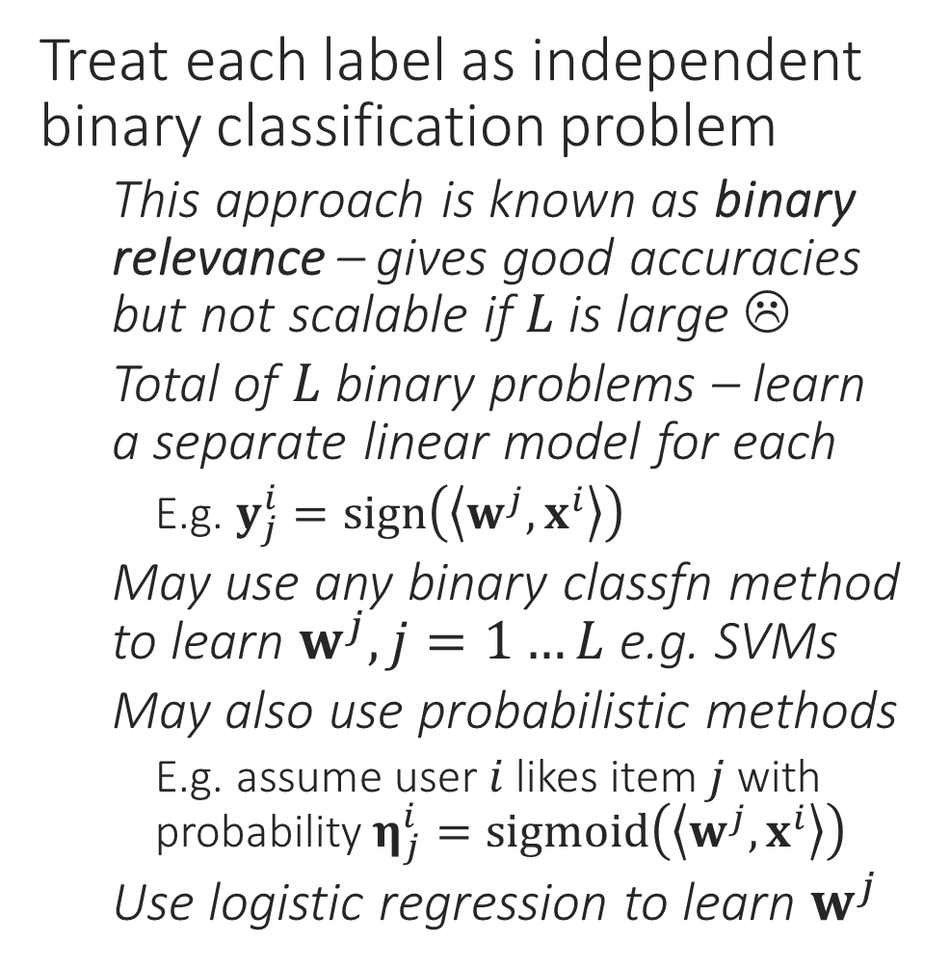
Recommendation using Linear Models
Treat each label as independent binary classification problem
This approach is known as binary relevance – gives good accuracies but not scalable if $L$ is large ☹
Total of $L$ binary problems – learn a separate linear model for each
E.g. $y_{j}^{i}=sign\left(\left\langle w^{j},x^{i}\right\rangle \right)$
May use any binary classfn method to learn $w^{j},j=1…L$ e.g. SVMs
May also use probabilistic methods
E.g. assume user $i$ likes item $j$ with probability $η_{j}^{i}=sigmoid\left(\left\langle w^{j},x^{i}\right\rangle \right)$
Use logistic regression to learn $w^{j}$
$$x^{i}∈ℝ^{d}$$
$$y^{i}∈{\left\{0,1\right\}}^{L}$$
$$η^{i}∈{\left[0,1\right]}^{L}$$

Slide 15
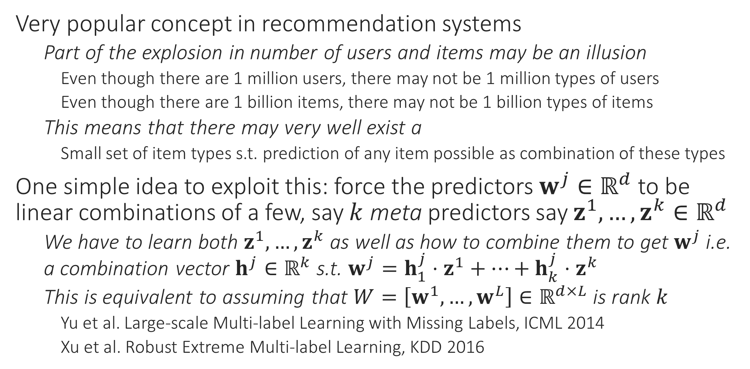
Recommendation using Latent Variables
Very popular concept in recommendation systems
Part of the explosion in number of users and items may be an illusion
Even though there are 1 million users, there may not be 1 million types of users
Even though there are 1 billion items, there may not be 1 billion types of items
This means that there may very well exist a
Small set of item types s.t. prediction of any item possible as combination of these types
One simple idea to exploit this: force the predictors $w^{j}∈ℝ^{d}$ to be linear combinations of a few, say $k$ meta predictors say $z^{1},…,z^{k}∈ℝ^{d}$
We have to learn both $z^{1},…,z^{k}$ as well as how to combine them to get $w^{j}$ i.e. a combination vector $h^{j}∈ℝ^{k}$ s.t. $w^{j}=h_{1}^{j}⋅z^{1}+…+h_{k}^{j}⋅z^{k}$
This is equivalent to assuming that $W=\left[w^{1},…,w^{L}\right]∈ℝ^{d×L}$ is rank $k$
Yu et al. Large-scale Multi-label Learning with Missing Labels, ICML 2014
Xu et al. Robust Extreme Multi-label Learning, KDD 2016

Slide 16



Recommendation using Latent Variables
0
+
1
+
1
+
0

Slide 17
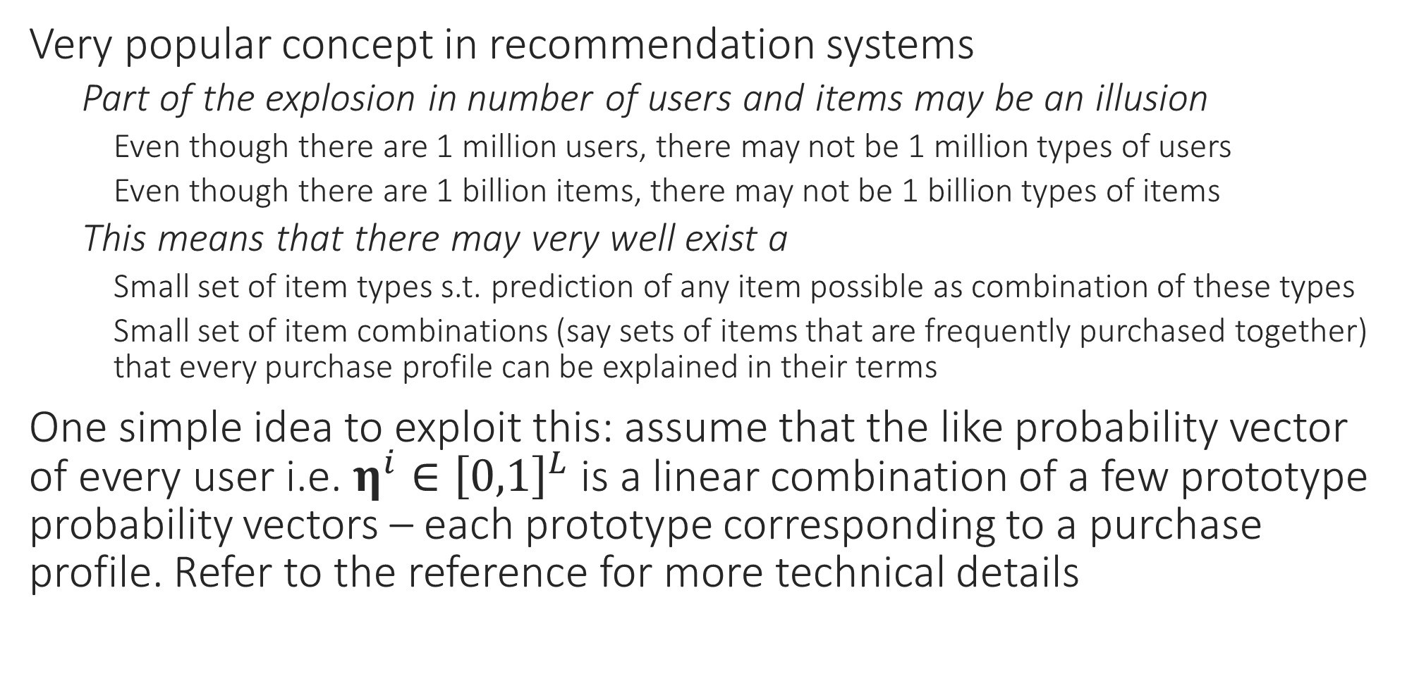
Recommendation using Latent Variables
Very popular concept in recommendation systems
Part of the explosion in number of users and items may be an illusion
Even though there are 1 million users, there may not be 1 million types of users
Even though there are 1 billion items, there may not be 1 billion types of items
This means that there may very well exist a
Small set of item types s.t. prediction of any item possible as combination of these types
Small set of item combinations (say sets of items that are frequently purchased together) that every purchase profile can be explained in their terms
One simple idea to exploit this: assume that the like probability vector of every user i.e. $η^{i}∈{\left[0,1\right]}^{L}$ is a linear combination of a few prototype probability vectors – each prototype corresponding to a purchase profile. Refer to the reference for more technical details

Slide 18





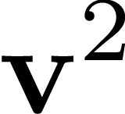
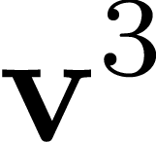
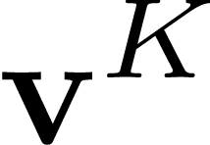

Recommendation using Latent Variables
+
+
+

Slide 19
Extreme Multi-label Classification
Pros
Very powerful – can extend to millions of items and users
State-of-the-art accuracies and very fast training and predictions
Indications that several major commercial systems use this in some form
Can utilize user and item features easily
Can add new users easily
Cons
No explicit collaboration – does not infer similarity of items/users
May pose an issue if user features are not very informative
Not straightforward to add new items
Recommendations can get stale with time
Common trick – retrain models frequently e.g. nightly, monthly

Slide 20
Recommendation via Online Learning
Need for explore exploit techniques
Useful in discovering user tastes of which we are not aware, of which even the user themself may not be aware
The Multi-armed Bandit Framework
Widely used in recommendation systems to assess utility of a recommendation
Also used in ensemble learning systems and “flighting” systems to assess the utility of various algorithms in offering good performance
Also forms a basis of more powerful models like Reinforcement Learning
The name derives from “one-armed bandit”, a colloquial name for slot machines in casinos – they were called so because of the single lever they have (the single “arm”) which has to be pulled in order to bet on the machine. The machines frequently rob users of their money hence the name “bandit” ☺

Slide 21
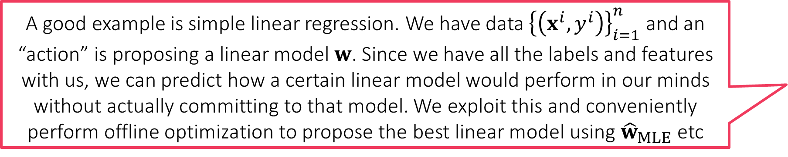
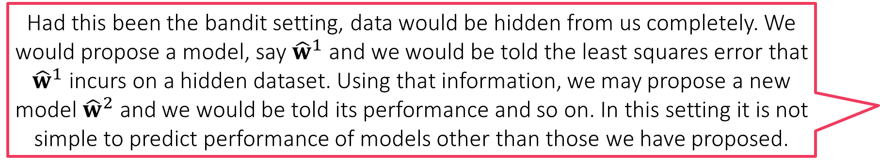
The Need for Exploration
The opposite of bandit setting is “full information” setting where we can reliably predict the reward we would get for this action or that action even without performing that action
Collaborative Filtering and Extreme Classification are static techniques
Even if they learn a good set of items for a user, they will keep making the same recommendation no matter how many times the user visits the website
Can make users feel bored – content seems stale. Also missed opportunity to suggest something new and fresh that even the user did not know they liked!
No exploration – usually a small set of items get recommended to everybody - other items get starved and sellers of those items may leave marketplace ☹
Bandit algorithms remedy this by using explore-exploit techniques
Bandit algorithms work with “bandit” feedback. They get feedback only for the action they perform, not for any action that they did not perform
E.g., we can only get clicks on items that we actually recommend to users. Cannot hope to get clicks if an item has not even been displayed on the website as an ad
E.g., if playing Mario, can only get points (rewards) for actions (e.g. jump/stomp) we actually perform. No way to propose an action hypothetically and expect rewards/coins
A good example is simple linear regression. We have data ${\left\{\left(x^{i},y^{i}\right)\right\}}_{i=1}^{n}$ and an “action” is proposing a linear model $w$. Since we have all the labels and features with us, we can predict how a certain linear model would perform in our minds without actually committing to that model. We exploit this and conveniently perform offline optimization to propose the best linear model using ${\hat{w}}_{MLE}$ etc
Had this been the bandit setting, data would be hidden from us completely. We would propose a model, say ${\hat{w}}^{1}$ and we would be told the least squares error that ${\hat{w}}^{1}$ incurs on a hidden dataset. Using that information, we may propose a new model ${\hat{w}}^{2}$ and we would be told its performance and so on. In this setting it is not simple to predict performance of models other than those we have proposed.

Slide 22
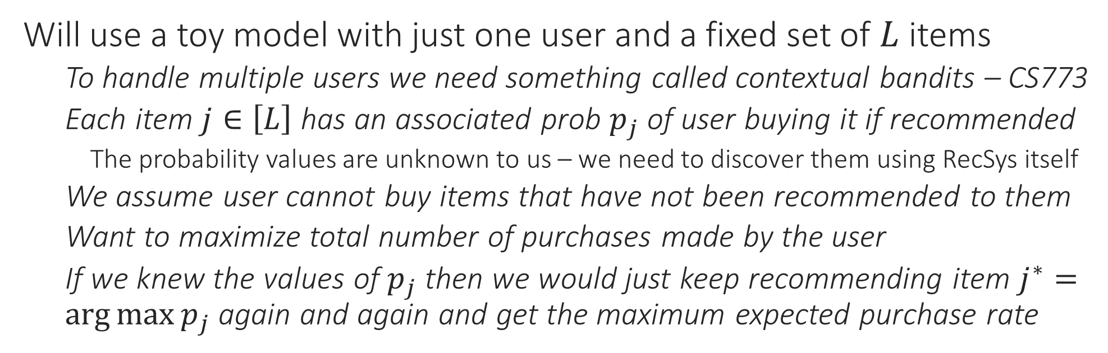
The Multi-armed Bandit
Will use a toy model with just one user and a fixed set of $L$ items
To handle multiple users we need something called contextual bandits – CS773
Each item $j∈\left[L\right]$ has an associated prob $p_{j}$ of user buying it if recommended
The probability values are unknown to us – we need to discover them using RecSys itself
We assume user cannot buy items that have not been recommended to them
Want to maximize total number of purchases made by the user
If we knew the values of $p_{j}$ then we would just keep recommending item $j^{∗}=\arg{\max{p_{j}}}$ again and again and get the maximum expected purchase rate

Slide 23
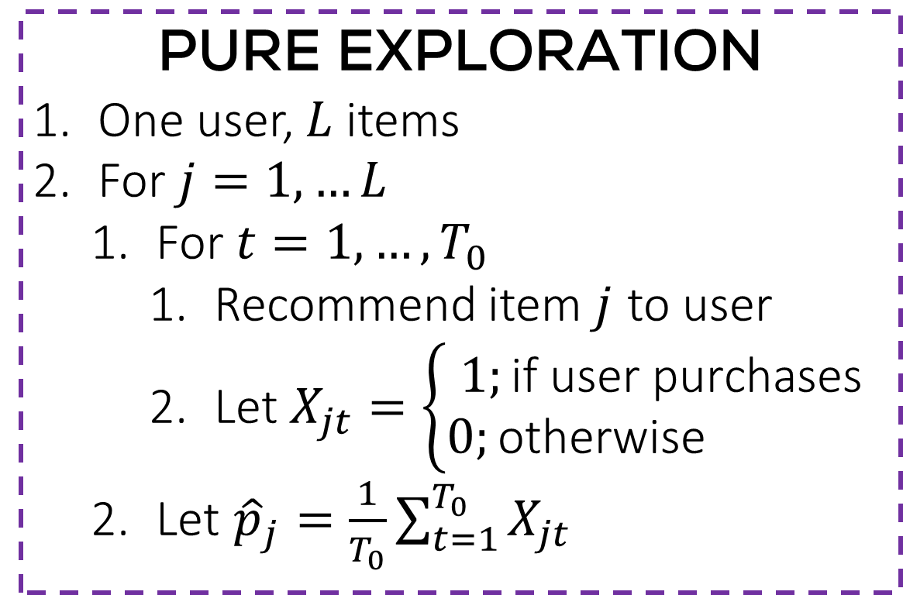
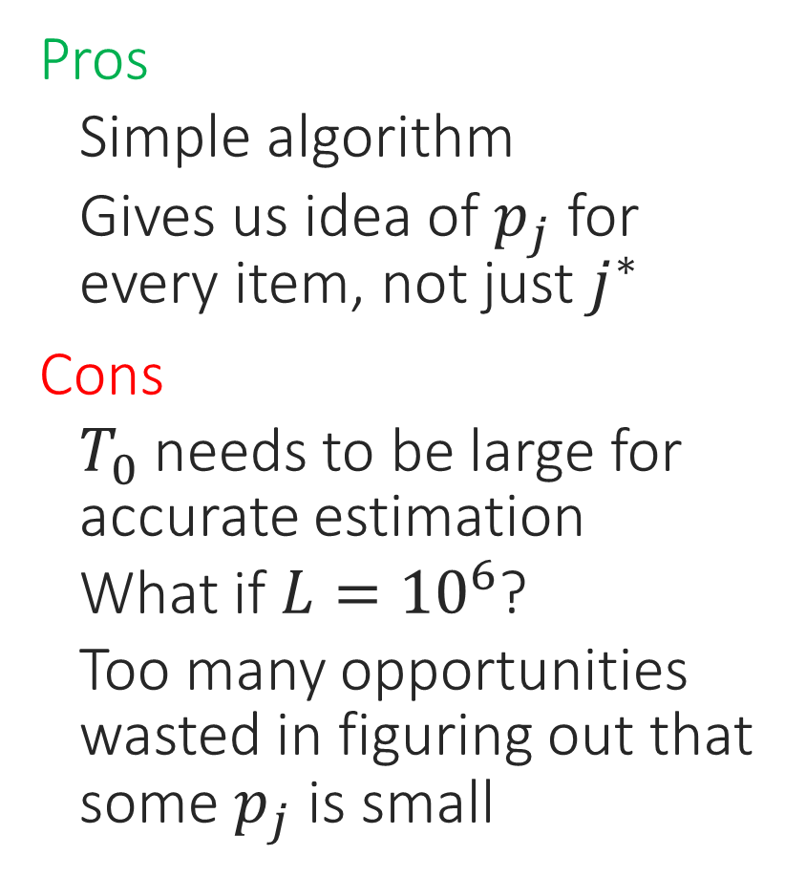
A Pure Exploration Algorithm
Pros
Simple algorithm
Gives us idea of $p_{j}$ for every item, not just $j^{∗}$
Cons
$T_{0}$ needs to be large for accurate estimation
What if $L={10}^{6}$?
Too many opportunities wasted in figuring out that some $p_{j}$ is small
PURE EXPLORATION
One user, $L$ items
For $j=1,…L$
For $t=1,…,T_{0}$
Recommend item $j$ to user
Let $X_{jt}=\left\{\begin{aligned}1;\text{if} \text{user} \text{purchases} \\ 0;\text{otherwise} \end{aligned}\right.$
Let ${\hat{p}}_{j}=\frac{1}{T_{0}}\sum_{t=1}^{T_{0}}{X_{jt}}$

Slide 24
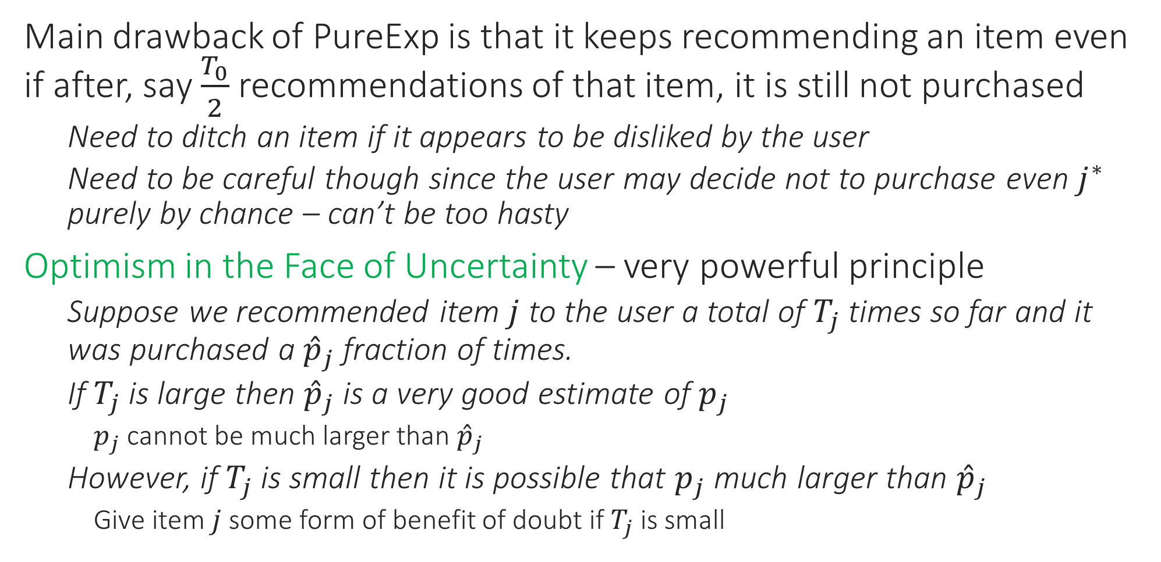
Optimism in the Face of Uncertainty
Main drawback of PureExp is that it keeps recommending an item even if after, say $\frac{T_{0}}{2}$ recommendations of that item, it is still not purchased
Need to ditch an item if it appears to be disliked by the user
Need to be careful though since the user may decide not to purchase even $j^{∗}$ purely by chance – can’t be too hasty
Optimism in the Face of Uncertainty – very powerful principle
Suppose we recommended item $j$ to the user a total of $T_{j}$ times so far and it was purchased a ${\hat{p}}_{j}$ fraction of times.
If $T_{j}$ is large then ${\hat{p}}_{j}$ is a very good estimate of $p_{j}$
$p_{j}$ cannot be much larger than ${\hat{p}}_{j}$
However, if $T_{j}$ is small then it is possible that $p_{j}$ much larger than ${\hat{p}}_{j}$
Give item $j$ some form of benefit of doubt if $T_{j}$ is small

Slide 25
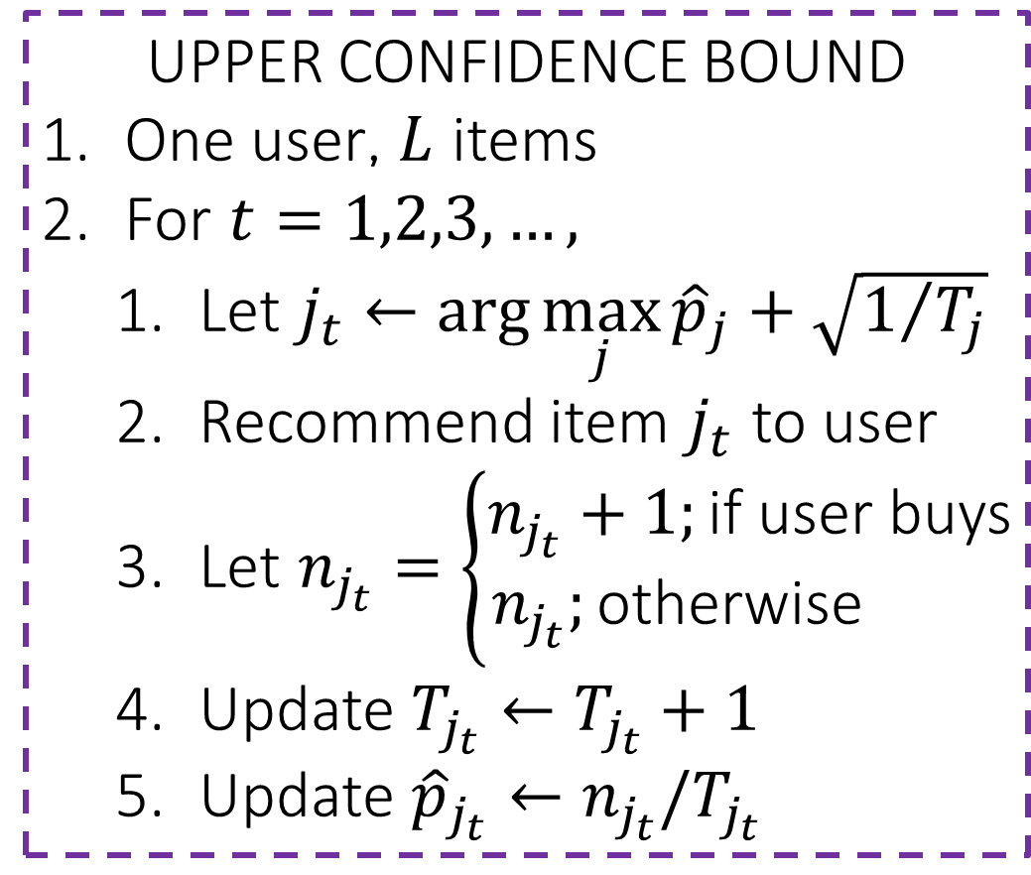
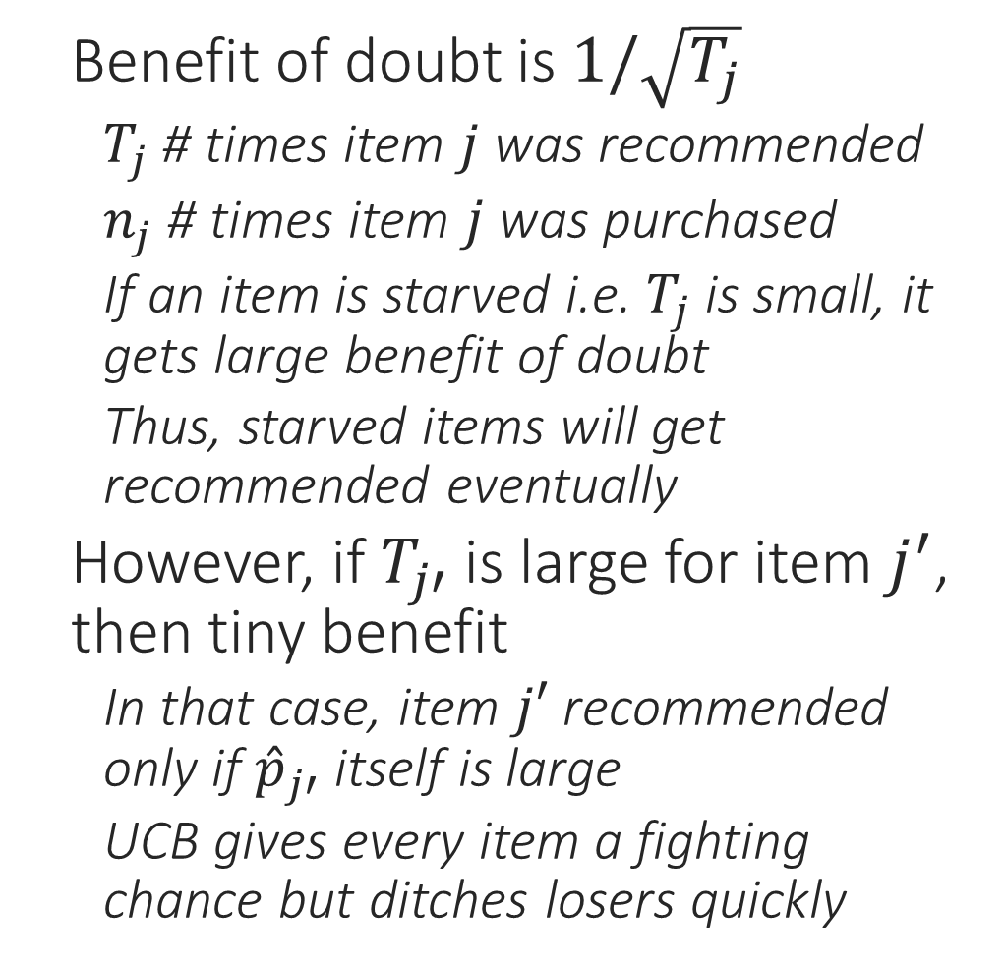
The UCB Algorithm
Initially, may want to recommend all items at least once to avoid divide-by-zero errors
Benefit of doubt is $1/\sqrt{T_{j}}$
$T_{j}$ # times item $j$ was recommended
$n_{j}$ # times item $j$ was purchased
If an item is starved i.e. $T_{j}$ is small, it gets large benefit of doubt
Thus, starved items will get recommended eventually
However, if $T_{j′}$ is large for item $j^{′}$, then tiny benefit
In that case, item $j′$ recommended only if ${\hat{p}}_{j′}$ itself is large
UCB gives every item a fighting chance but ditches losers quickly
UPPER CONFIDENCE BOUND
One user, $L$ items
For $t=1,2,3,…,$
Let $j_{t}←\arg{\max_{j}{{\hat{p}}_{j}+\sqrt{1/{T_{j}}}}}$
Recommend item $j_{t}$ to user
Let $n_{j_{t}}=\left\{\begin{aligned}n_{j_{t}}+1;\text{if} \text{user} \text{buys} \\ n_{j_{t}};\text{otherwise} \end{aligned}\right.$
Update $T_{j_{t}}←T_{j_{t}}+1$
Update ${\hat{p}}_{j_{t}}←n_{j_{t}}/T_{j_{t}}$

Slide 26
Explore Exploit
Pros
Online and not static, learns continuously (even if user tastes change)
Does not get stale very easily – explores!
Can utilize user and item features easily (contextual bandits)
Can add new users and new items easily
Cons
No explicit collaboration – does not infer similarity of items/users
Modifications do exist for “collaborative contextual bandits” e.g. Li et al ICML 2017
Need powerful contextual models to handle large item sets
Algorithms more complicated, expensive in contextual bandits
Explore exploit algorithms are a prominent RecSys tool

Slide 27
Comments
Think of a game of Mario – not only may a false move give less reward right now, it may also make it impossible to win the game overall ☹
In practice, ensemble methods popular in RecSys
Most commercial recsys are massive ensembles with 100s of algorithms running in tandem. Exact details usually closely guarded secrets
Recent advances focus on getting best of all many methodologies
E.g. matrix factorization where rows and columns have side features
E.g. collaborative multi-armed bandits – identifies similar items/users
Reinforcement Learning generalizes notion of bandit algorithms
Bandit algorithms usually assume that any action/proposal only generates a reward but does not change the reward function
E.g. recommending an item (whether liked or disliked) not expected to change user’s tastes drastically
RL removes this assumption – not only do our actions generate feedback from user, they may also fundamentally change the way the user gives future feedback – need to be much more careful in this model

